Slide 1



Bioinformatics approaches to understand RNA biology in the rice blast fungus
Marco Marconi
Center for Plant Biotechnology and Genomics Technical University of Madrid

Slide 2
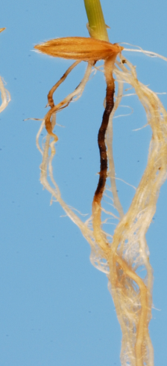
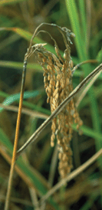
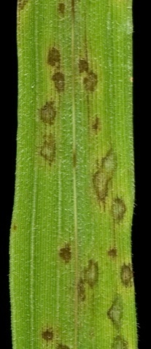
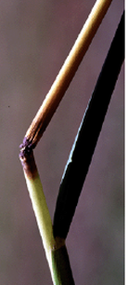
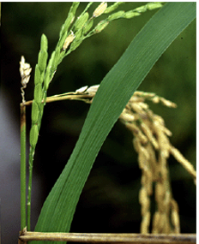
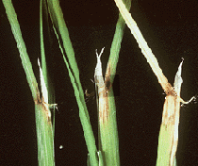
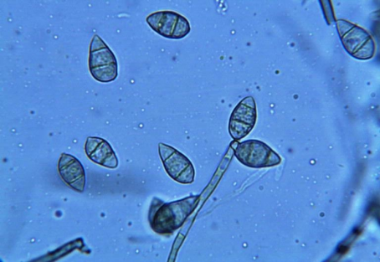
Magnaporthe oryzae is an ascomycete fungus that infects rice
root
panicle
node
leaf
Sesma&Osbourn Nature (2004)
neck
collar
Notes:
Magnaporthe oryzae is an ascomycete fungus that infects rice, it is worldwide speard and can infect different rice tissues

Slide 3
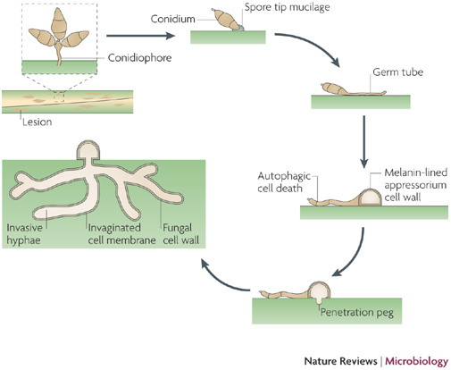
Magnaporthe oryzae life cycle
Richard A. Wilson & Nicholas J. TalbotNature Reviews Microbiology 7, 185-195 (March 2009)
Notes:
Magnaporthe life cycle starts with a spore landing on the plant, from where a puncturing structure called “appressorium” is developed. The fungus then penetrate the cells, reproduces and the cycle starts over again

Slide 4
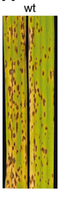
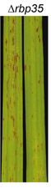
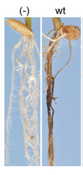
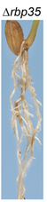
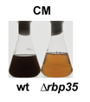
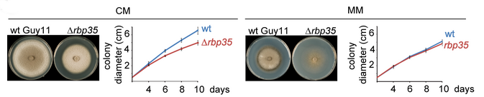
We are interested in two pathogenic-defective mutants…
Δrbp35
Marina Franceschetti , Emilio Bueno , Richard A. Wilson, Sara L. Tucker, Concepción Gómez-Mena, Grant Calder, Ane Sesma 2011
Notes:
We are interested in two mutants, one is the rbp35 gene, you can see here it’s defective in pathogenicity and development

Slide 5
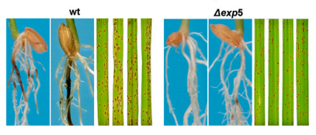
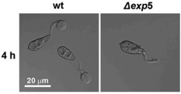
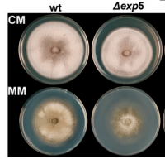
We are interested in two pathogenic-defective mutants…
Δexp5
Tucker SL1, Besi MI, Galhano R, Franceschetti M, Goetz S, Lenhert S, Osbourn A, Sesma A. 2010
Notes:
The other one in exp5, defective in pathogenicity and growing as well.

Slide 6

RBP35 is a member of the polyadenylation machinery
Pre-mRNA
CDS
Cleavage
CDS
Polyadenylation
CDS
AAAAAAAAAA
Notes:
Rbp35 is a member on the polyadenylation machinery. As you all probably already know, polyadenylation is the process where a nascent messenger RNA is cleaved and added with adenines

Slide 7
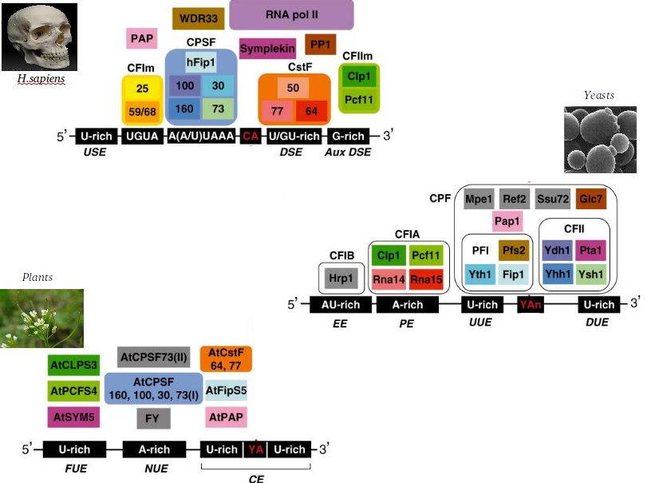
RBP35 is a member of the polyadenylation machinery
S Millevoi et al. ‎2010
Notes:
The polyadenylation machinery is conserved in all eukariotic organisms

Slide 8
RBP35 is a member of the polyadenylation machinery
RBP35 ortholog found in animals,
but not in yeast!
!
S Millevoi et al. ‎2010
Notes:
But the orthologs of rbp35 is not found in yeast, while it is present in animals

Slide 9
Human RBP35 orthologue bind to UGUA elements to regulate the selection of alternative polyadenylation sites (APA)
AAAAAAAAAAAAAAAAAAAA
Poly(A) site
CFI25
Rbp35
UGUA
AAAAAAAAAA
Alternative poly(A) site
Notes:
RBP35 is involved in alternative polyadenylation, a process where different polyadenylation sites can be selected on the same transcript, depending on specific binding elements

Slide 10
EXP5 is a kariopherin involved in the nuclear import/export of proteins and RNAs
METAZOAN
YEAST
double-stranded RNAs
binding proteins
tRNAs
aminoacyl-tRNA
re-export
ILF3, EF1A, JAZ…
EXP5
(metazoan)
MSN5
(yeast)
Some transcription factors
micro-RNA
precursors
RanGTP
RanGTP
NUCLEUS
Notes:
EXP5 is a kariopherin involved in the nuclear import/export. In animals it exports mostly double stranded RNAs and a few proteins, in yeast, it is involved in tRNA re-export and some transcription factors export

Slide 11
We want to shed light on the role of RBP35 and EXP5 in M.oryzae:
RNA-seq on polyadenylation sites
AAAAAAAAAAAAAAAAAAAA
AAAAAAAAAA
Notes:
So, we want to know something more about these mutants. We have performed a poyadenylation sites sequencing, in order to know the role of Rbp35 in alternative polyadenylation

Slide 12
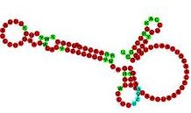


We want to shed light on the role of RBP35 and EXP5 in M.oryzae:
RNA-seq on polyadenylation sites
Small RNA-sequencing
?
?
?
?
Notes:
And a smallRNA sequencing, in order to know how exp5 and rbp35 regulate the non-coding RNA population in magnaporthe oryzae

Slide 13
We want to shed light on the role of RBP35 and EXP5 in M.oryzae:
RNA-seq on polyadenylation sites
Small RNA-seq
Evolutionary analysis of polyadenylation/splicing/translation machineries
Notes:
We are also studing the evolutionary history of several protein complexes in fungi, but we are not seeing this in this today

Slide 14
We want to shed light on the role of RBP35 and EXP5 in M.oryzae:
RNA-seq on polyadenylation sites
AAAAAAAAAAAAAAAAAAAA
AAAAAAAAAA

Slide 15

Sequencing details
Two strains:
WT
∆rbp35
Four nutrient conditions:
Complete medium
Minimal medium
Nitrogen starvation
Carbon starvation
3 Replicates:
#1, #2, #3
Coverage:
400x poly(A) site
Typical on-plant conditions
Julio Rodríguez-Romero
(Wilkening et al., Nucleic Acids Res. 2013 , 1–8. An efficient method for genome-wide polyadenylation site mapping and RNA quantification)

Slide 16
Poly(A) site mapping analysis
Results in wild-type
Results in the ∆rbp35 mutant
Notes:
APA -

Slide 17
Poly(A) site mapping analysis
Results in wild-type
Results in the ∆rbp35 mutant
Notes:
APA -

Slide 18

5’UTR
3’UTR
Start codon
Stop codon
Notes:
This is how a typical mapping on a gene look like

Slide 19
~14000 poly(A) sites were identified on the genome
5’UTR
3’UTR
Start codon
Stop codon

Slide 20
~14000 poly(A) sites were identified on the genome
5’UTR
3’UTR
Start codon
Stop codon
90% located in the 3’UTR

Slide 21
~14000 poly(A) sites were identified on the genome
5’UTR
3’UTR
Start codon
Stop codon
~7500 genes with at least one poly(A) site
90% located in the 3’UTR

Slide 22
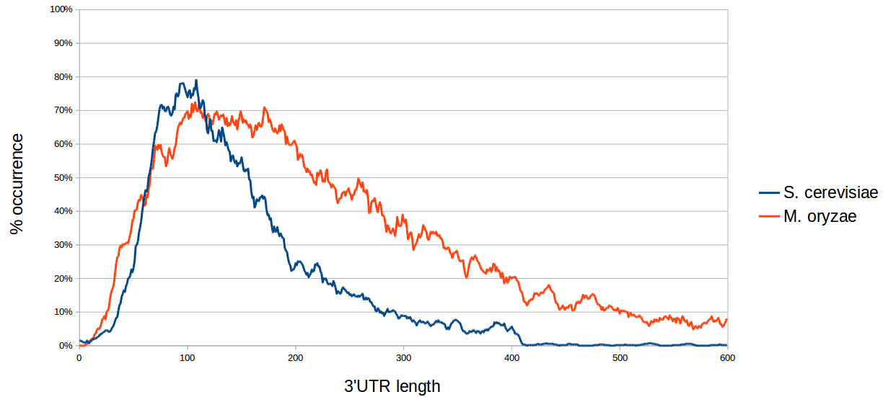
Magnaporthe oryzae 3’ UTR lengths are usually longer than Yeast

Slide 23
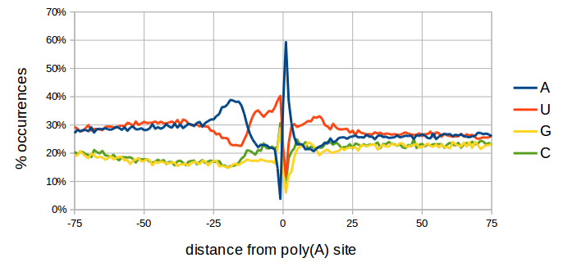
Nucleotide Profile of poly(A) site differs slightly from yeast
YEAST
AU-rich
A-rich
U-rich
Y A
U-rich
Notes:
Also, the nucleotide profile around the poly(A) site is different. Here you can see the yeast elements well described in the literature

Slide 24
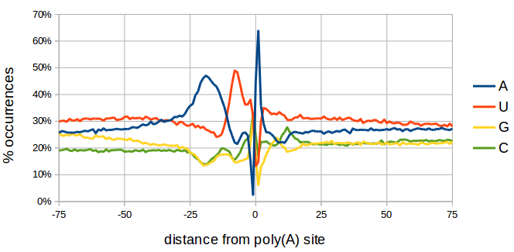
Nucleotide Profile of poly(A) site differs slightly from yeast
YEAST
AU-rich
A-rich
U-rich
Y A
U-rich
UGUA
UAGA
A-rich
U-rich
S A
C peak
M.oryzae
Notes:
But in M.oryzae we find a different situation, With a different cut-site. The down-stream U-rich region is missing, and the upstream Au-rich region is replace by two specific elements

Slide 25
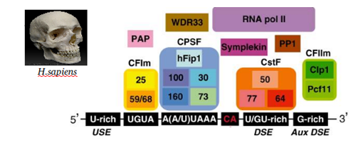
Contrary to metazoan, fungal canonical AAUAAA polyadenylation signal is highly degenerated
Very uniform
in animals

Slide 26
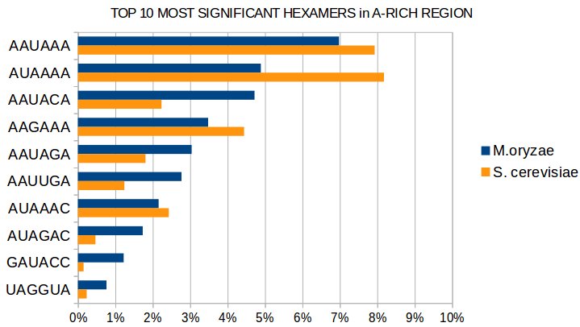
Contrary to metazoan, fungal canonical AAUAAA polyadenylation signal is highly degenerated
Very uniform
in animals
Only 7% in fungi!

Slide 27
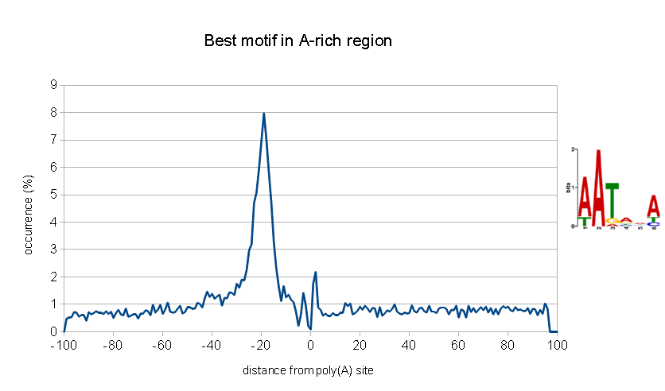
Contrary to metazoan, fungal canonical AAUAAA polyadenylation signal is highly degenerated
Very uniform
in animals
Only 7% in fungi!
Very degenerated!

Slide 28
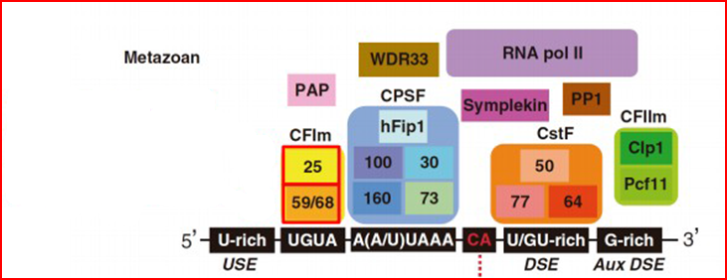
As in metazoan, M. oryzae has a UGUA motif,
together with a new UAGA motif
RBP35

Slide 29
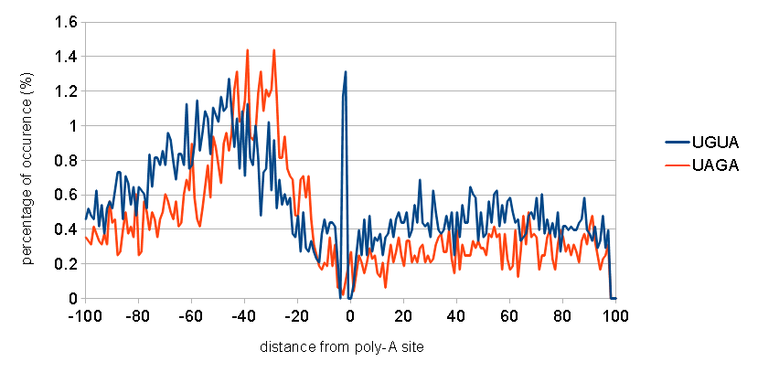
As in metazoan, M. oryzae has a UGUA motif,
together with a new UAGA motif
RBP35

Slide 30
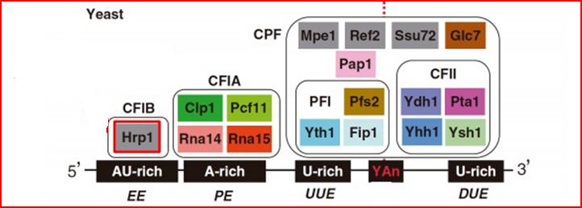
The motif bound by Hrp1 in yeast is missing is M. oryzae
M. oryzae has this
protein, Hrp1
Notes:
The polyadenylation machinery in the fungal kingdom is characterized but a protein Hrp1, known to bin AU-rich region in yeast.

Slide 31
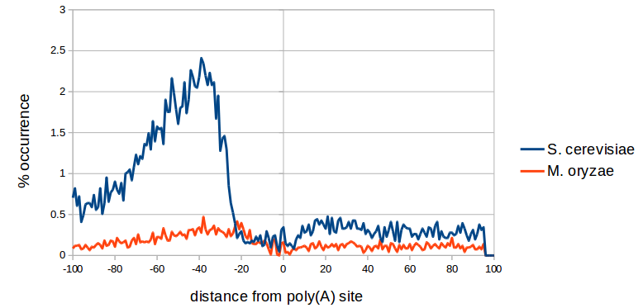
The motif bound by Hrp1 in yeast is missing is M. oryzae
But the AU-rich element it binds in yeast is missing here!
M. oryzae has this
protein, Hrp1
Notes:
But, even if this protein is present in filamentous fungi, the AU-rich element is not. So, what does Hrp1 bind?

Slide 32
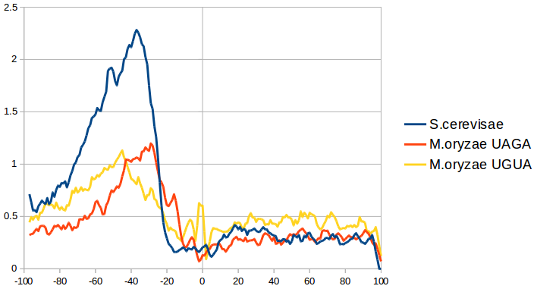
The motif bound by Hrp1 in yeast is missing is M. oryzae
But the AU-rich element it binds in yeast is missing here!
Maybe the AU-rich element is the “fusion” of UGUA and UAGA, when the CFI complex was lost in yeast
M. oryzae has this
protein, Hrp1

Slide 33
What about alternative polyadenylation?
AAAAAAAAAAAAAAAAAAAA
Different cleavage sites produce
Alternative mRNA isoforms
AAAAAAAAAA

Slide 34
What about alternative polyadenylation?
AAAAAAAAAAAAAAAAAAAA
Different cleavage sites produce
Alternative mRNA isoforms
AAAAAAAAAA
Subcellular
localisation
???
Translation
efficiency
degradation

Slide 35
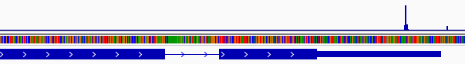
In M. oryzae ~30% of genes are alternatively polyadenylated
3’UTR

Slide 36
3’UTR
90% of APA events occur in the 3’UTR

Slide 37
80% of APA events are made of 2 alternatives only
3’UTR

Slide 38
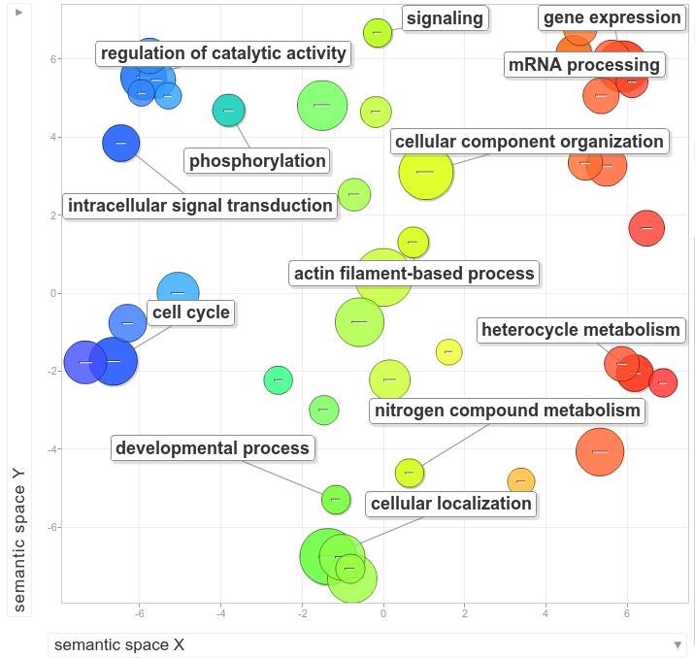
Alternative polyadenylation seems to be involved in specific biological processes
"REVIGO summarizes and visualizes long lists of Gene Ontology terms“ PLoS ONE 2011

Slide 39
Carbon Starvation affects poly(A) selection in 455 genes, preferring distal poly(A) sites
Complete medium
AAAAAAAAAAAAAAAAAAAA
In carbon starvation longer UTRs are usually produced
Carbon starvation
AAAAAAAAAA
Notes:
And this results in the fungus having longer 3’UTRs

Slide 40
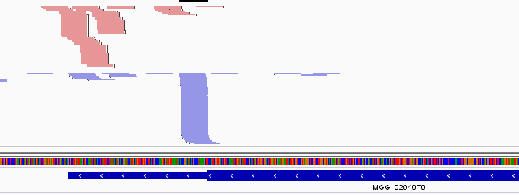
Antisense poly(A) sites are widespread
antisense
sense
3’UTR
Notes:
At least 1000 genes present some kind of antisense transcription. We don’t know the effect of this fenomenon

Slide 41
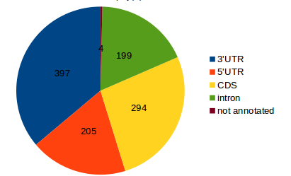
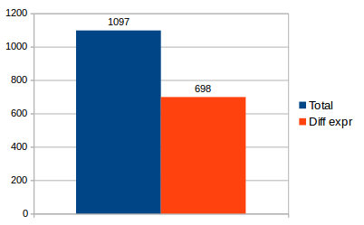
Antisense poly(A) sites are widespread
antisense
sense
3’UTR
Notes:
But the antisense transcripts are usually located in the 3’UTR, and most of them are differentially expressed between conditions, so there could be a functional significance

Slide 42
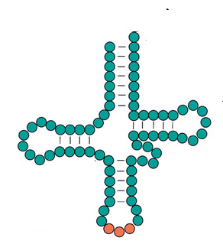
tRNAs are also polyadenylated
tRNA’s “3’UTR”
AAAAAAAAA…
Notes:
Almost strangely, tRNA are also polyadenylated. They possess a very short “3’UTR” as we can call it

Slide 43
tRNAs are also polyadenylated
tRNA’s “3’UTR”
AAAAAAAAA…
Adding
CCA
Aminoacid
Miracle
here
Notes:
And they are subsequently processed into theis final form.

Slide 44
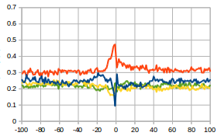
tRNAs are also polyadenylated
tRNA’s “3’UTR”
AAAAAAAAA…
Adding
CCA
Aminoacid
Miracle
here
tRNA poly(A) site
Notes:
They nucleotide profile differs from regular poly(A) sites, meaning that they probably cleaved by a different machinery

Slide 45
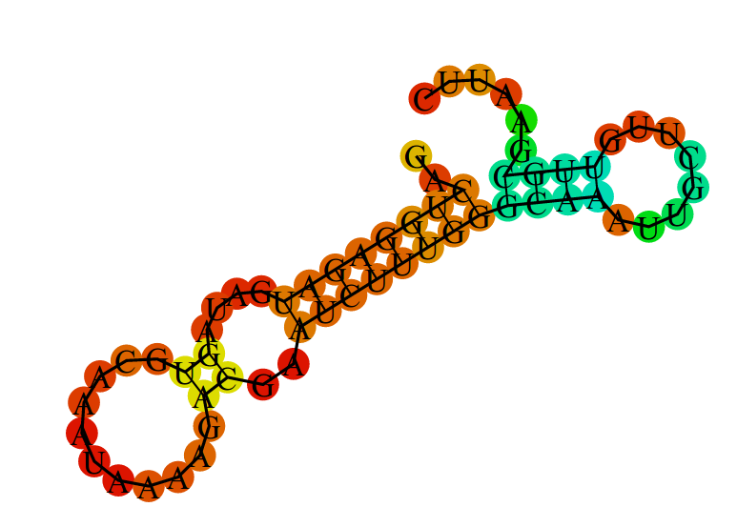
The polyadenylation site region has a defined secondary structure
The A-rich region is usually
not structured
The polyadenylation site is usually structured and located before an hairpin-loop

Slide 46
Poly(A) site mapping analysis
Results in wild-type
Results in the ∆rbp35 mutant
Notes:
APA -

Slide 47
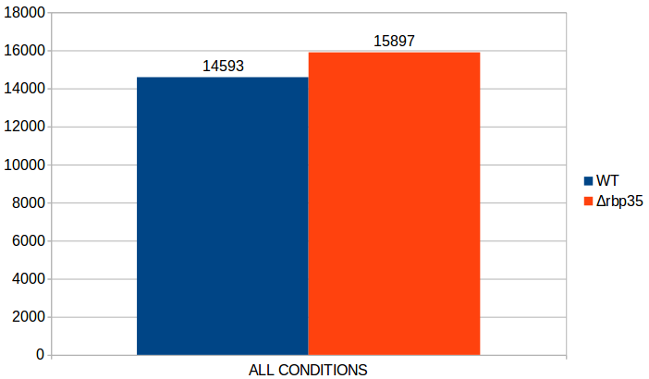
∆rbp35 increases the number of Poly-A sites

Slide 48
~25% of M. oryzae’s genes have a different poly(A) site usage in ∆rbp35
Wild type
AAAAAAAAAA
In the mutant, shorter UTRs are usually preferred
∆rbp35
AAAAAAAAAAAAAAAAAAAA

Slide 49
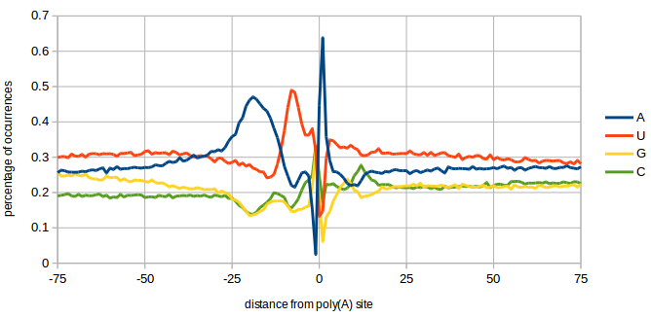
RBP35-dependent poly(A) sites are less likely to possess the canonical AAUAAA sequence
A-rich

Slide 50
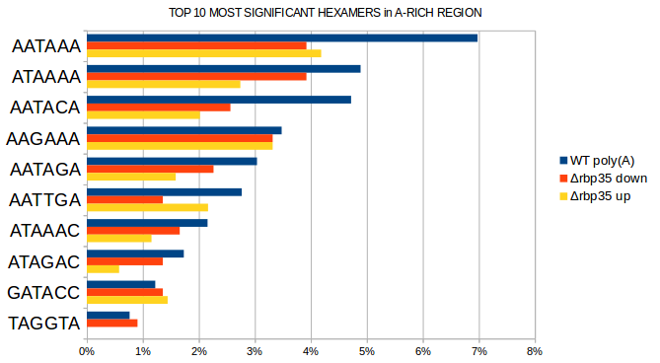
RBP35-dependent poly(A) sites are less likely to possess the canonical AAUAAA sequence
A-rich

Slide 51
UGUA motif is very enriched in down-regulated poly(A) sites in ∆rbp35
UGUA

Slide 52
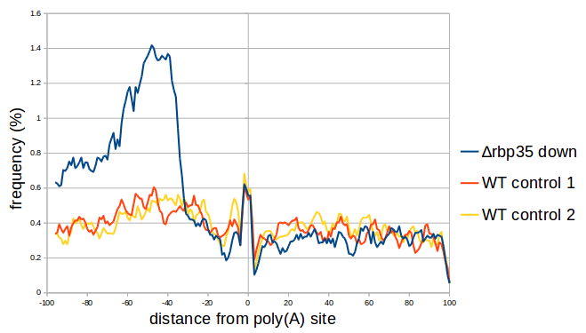
UGUA motif is very enriched in down-regulated poly(A) sites in ∆rbp35
E-value: 5.3e-103
UGUA

Slide 53
Can we devise an hypothetical role for RBP35?

Slide 54
The recognition of a proper UGUA motif by Rbp35 is essential for the cleavage reaction.
Wild type strain (common situation)
Rbp35/CFI25
5’
UGUA
-45
3’
Poly(A) site
Notes:
The recognition of a proper UGUA motif by Rbp35 is essential for the cleavage reaction.

Slide 55
The recognition of a proper UGUA motif by Rbp35 is essential for the cleavage reaction.
Wild type strain (common situation)
Wild type strain (alternative poly(A) site)
Rbp35/CFI25
Rbp35/CFI25
5’
5’
UGUA
UGUA
-45
3’
-45
3’
Poly(A) site
Poly(A) site “occluded” by RBP35
Notes:
Also, Rbp35 can help to occlude an alternative poly(A) site

Slide 56
The recognition of a proper UGUA motif by Rbp35 is essential for the cleavage reaction.
Wild type strain (common situation)
Wild type strain (alternative poly(A) site)
Rbp35/CFI25
Rbp35/CFI25
5’
5’
UGUA
UGUA
-45
3’
-45
3’
Poly(A) site
The mutant
Poly(A) site “occluded” by RBP35
Rbp35/CFI25
5’
UGUA
-45
3’
Poly(A) site “revealed”
Notes:
When the protein is missing, the occluded poly(A) site becomes visible and it is cleaved

Slide 57
Part 1 - Conclusions
Polyadenylation in M. oryzae differs from S. cerevisiae
Alternative polyadenylation in M. oryzae is common and related with specific functional groups
Carbon starvation induces longer 3’UTRs
RBP35 (probably) interacts with the UGUA element, to select distal poly(A) sites

Slide 58
We want to shed light on the role of RBP35 and EXP5 in M.oryzae:
RNA-seq on polyadenylation sites
Small RNA-sequencing
?
?
?
?

Slide 59
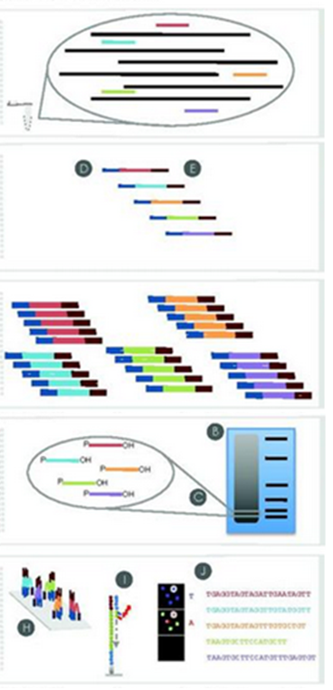
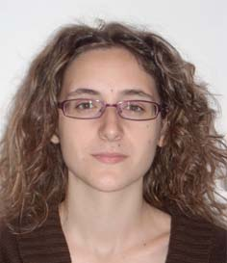
Small RNA library preparation and sequencing
Total RNA isolation
HD Adaptor ligation
Adriana Illana Otero,
in Norwich
RT & PCR
Size fractionation
Sequencing
Notes:
The library preparation was performed by adriana in norwich

Slide 60
Sequencing details
Three strains:
WT
∆exp5
∆rbp35
3 Replicates:
#1, #2, #3

Slide 61
Let’s see what we have on the annotated genome…..

Slide 62
Only 25% of reads map on the genome

Slide 63
∆rbp35 reads align slighty more

Slide 64
Most of genome sRNA loci (4131) are located in mRNAs

Slide 65
In ∆exp5, a lot of protein-coding related loci are down regulated

Slide 66
In ∆rbp35, a lot of transposable elements related loci are down regulated, and many ncRNA related loci are up regulated

Slide 67
…and this was 25% of the story, so let’s forget about the annotated genome for a while…

Slide 68
The majority of reads are of unknown origin
They don’t align against any database!

Slide 69
The majority of reads are of unknown origin

Slide 70
Many reads map to unknown ESTs non-aligning on the genome!
???

Slide 71
So, what’s happening in the mutants?

Slide 72
We cannot classify most of the changes in ∆exp5

Slide 73
We have more luck with ∆rbp35

Slide 74
We don’t know what they are… but at least, how do they look like?

Slide 75
We obtained reads in the range 18-25 bp

Slide 76
∆rbp35 reads look kind of shorter, and ∆exp5 reads are missing a peak at 14 bp…

Slide 77
In ∆exp5 we observe the down-regulation of very short fragments
Mostly rRNA and protein-coding genes
Mostly, the mysterious naESTs

Slide 78
In ∆exp5 we observe the down-regulation of very short fragments
The infamous naESTs again

Slide 79
In ∆rbp35 we observe a peak of up-regulated 19 nt sequences
Transposable elements, protein-coding genes and naEST

Slide 80
There is an overall U preference as 1st nucleotide, in reads with length 16-26 nt
Mainly in protein-coding genes and transposable elements

Slide 81

There is an overall U preference as 1st nucleotide, in reads with length 16-26 nt
Mainly in protein-coding genes and transposable elements
AGO
Certain proteins involved in RNA-interference like Argonaut have a preference for 5’ uraciles
U

Slide 82
∆rbp35 small RNAs with 1st nucleotide U-preference are up-regulated

Slide 83
There is an overall A preference as last nucleotide, in reads with length 17-29
Again, in protein-coding genes and transposable elements

Slide 84

There is an overall A preference as last nucleotide, in reads with length 17-29
Again, in protein-coding genes and transposable elements
A
But it is a post-transcriptional modification!
Also found in N.crassa:
Zhihong Xue, Haiyan Yuan, Jinhu Guo,* and Yi Liu† 2013

Slide 85
Last adenine preference is variable among mutants
Maybe that’s why it aligns better!

Slide 86
Transposable elements and naEST present a high degree of antisense transcription…
ncRNA rRNA transposable cDNA naEST

Slide 87
…incremented in the mutants
∆rbp35
∆exp5
transposable naEST

Slide 88
A new class of protein-coding related small RNA is found
Protein-coding gene
Unknown
smallRNA!

Slide 89
A new class of protein-coding related small RNA is found
Protein-coding gene
Unknown
smallRNA!
At least 12 protein-coding genes
Same situation conserved in other
filamentous fungi!
(but not yeasts)

Slide 90
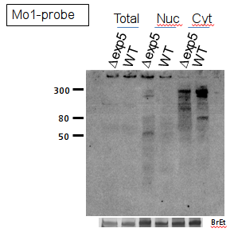
A new class of protein-coding related small RNA is found
Protein-coding gene
Unknown
smallRNA!
At least 12 protein-coding genes!
Same situation conserved in other
filamentous fungi!
(but not yeasts)

Slide 91
Part 2 - Conclusions
The small RNAs world of M. oryzae is mostly unknown and heterogeneous
The mutants affect different populations of small RNAs in different ways
A (maybe) new class of small RNA has been discovered

Slide 92
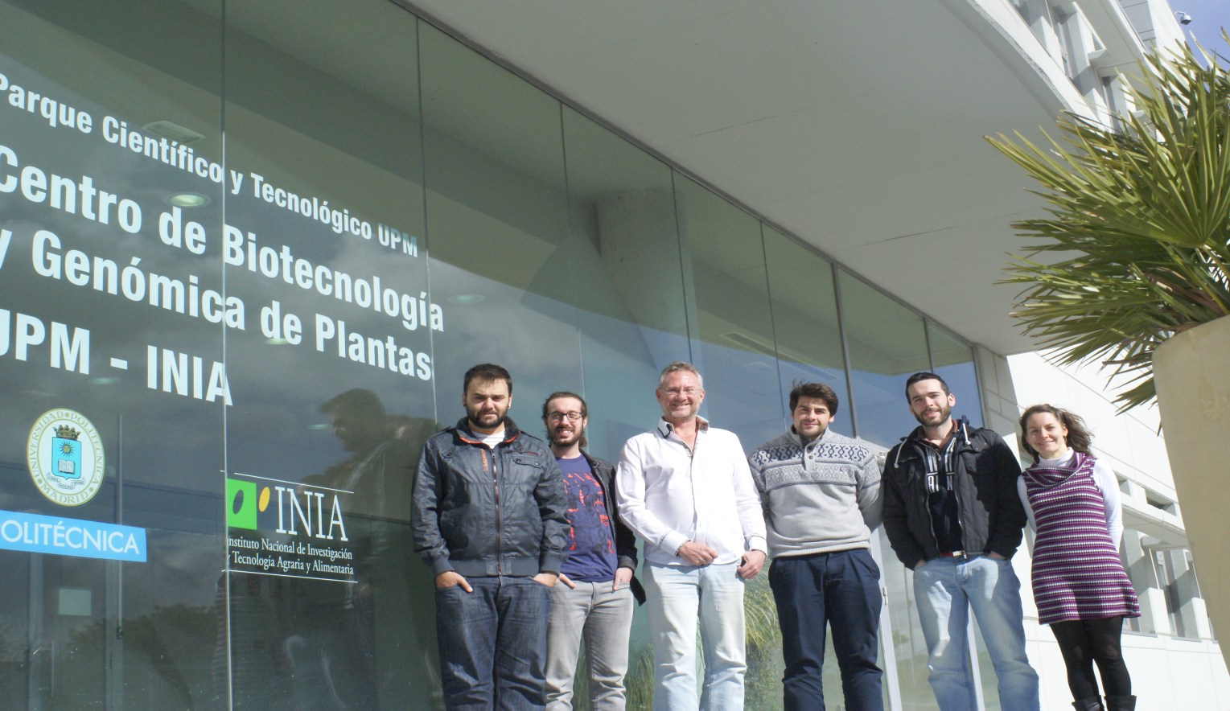
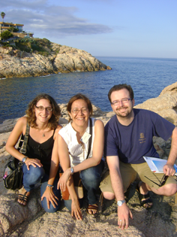
Acknowledgements

Slide 93

Questions?

